Slide 1
Gender equality and Quotas in Norway
Praha, October 13th 2014
Gina Lund and Hilde Thorkildsen

Slide 2
We…I am Gina
Lawyer by profession – have worked more than 15 years as a public servant in different fields and levels….and I am political addict
I have been active in the Labour Youth and Labour Party since I was 15 years old
I was a political adviser to the minister of Administration in the 90`s and until 2013 State Secretary/vice minister in the Ministry of Labour
I am currently living in East Jerusalem, Palestine
I am married, with one daughter (23) and two sons (16 and 25)
Notes:
I am so pleased and happy to be here in Prague and looking forward to participate in this mentoring programme.
I have learned that the discussion about quotas is really going on in the Czech republic. I am happy to share the Norwegian experiences

Slide 3
Are quotas a ”quick-fix” to inequality and injustice?
In my opinion; NO! quotas alone can make NO big change…
But, if you believe in Justice, Democracy and if you are ready to redistribute power, money and positions ------then quotas can be a good tool

Slide 4
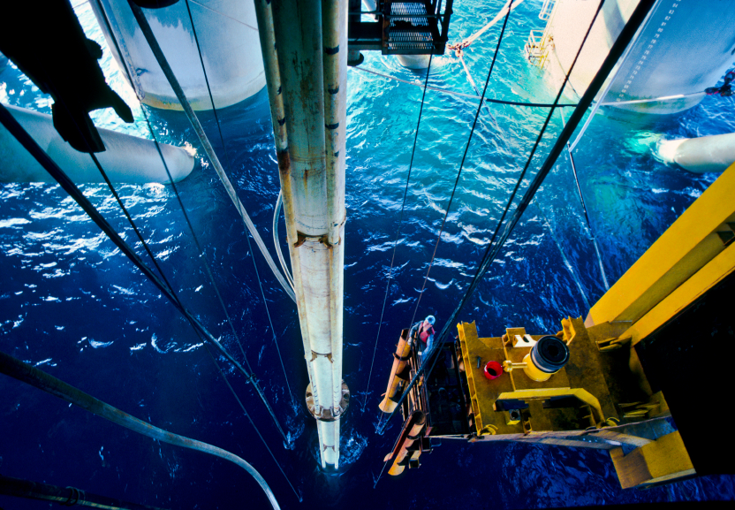
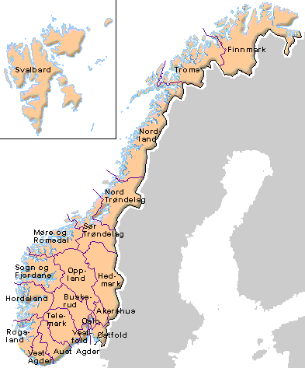
Facts and figures about Norway
Government
Population
Economy
Employment
Notes:
Parlamentary Constitutional Monarchy, The Labour Party has been the largest party in Parliament ever since the election of 1927 up to the recent 2009 election. Shortly you could say that the Labour based government has been ruling Norway fron second word war with the exception of five periodes . The government we have today won the election in 2013 – the electionwas wonby a centre-right coalition obtained a major vote and created government with based on the conservative party and our rightwing progressive party.The Christian democrats, and center right parties are supporting the gvernment but not represented in it.
Population I about 5 million…less than half of the population of Check republic…
Not EU members,- an economy mainly based on oil, gas, offshore, and fish
Employment rate is high,- among the highest in the word for women
Unemployment is low

Slide 5
Norway today
5.1 mill inhabitants
Approximately 73 % of all women are working – highest labour participation in the word due to female participation
The fertility rate is 1,9 children (among the highest in Europe)
Women earn 86 % of what men earn
Women are still in charge at home
We lack work force especially in the health sector

Slide 6
Was Norway born with a quota system?
Actually,- and surprisingly perhaps …but NO…my country was not born with quotas !
Its not even right that the quotas just happened to come to us…
Quotas are legitimate children of what today is known as the Norwegian or the Nordic Model

Slide 7
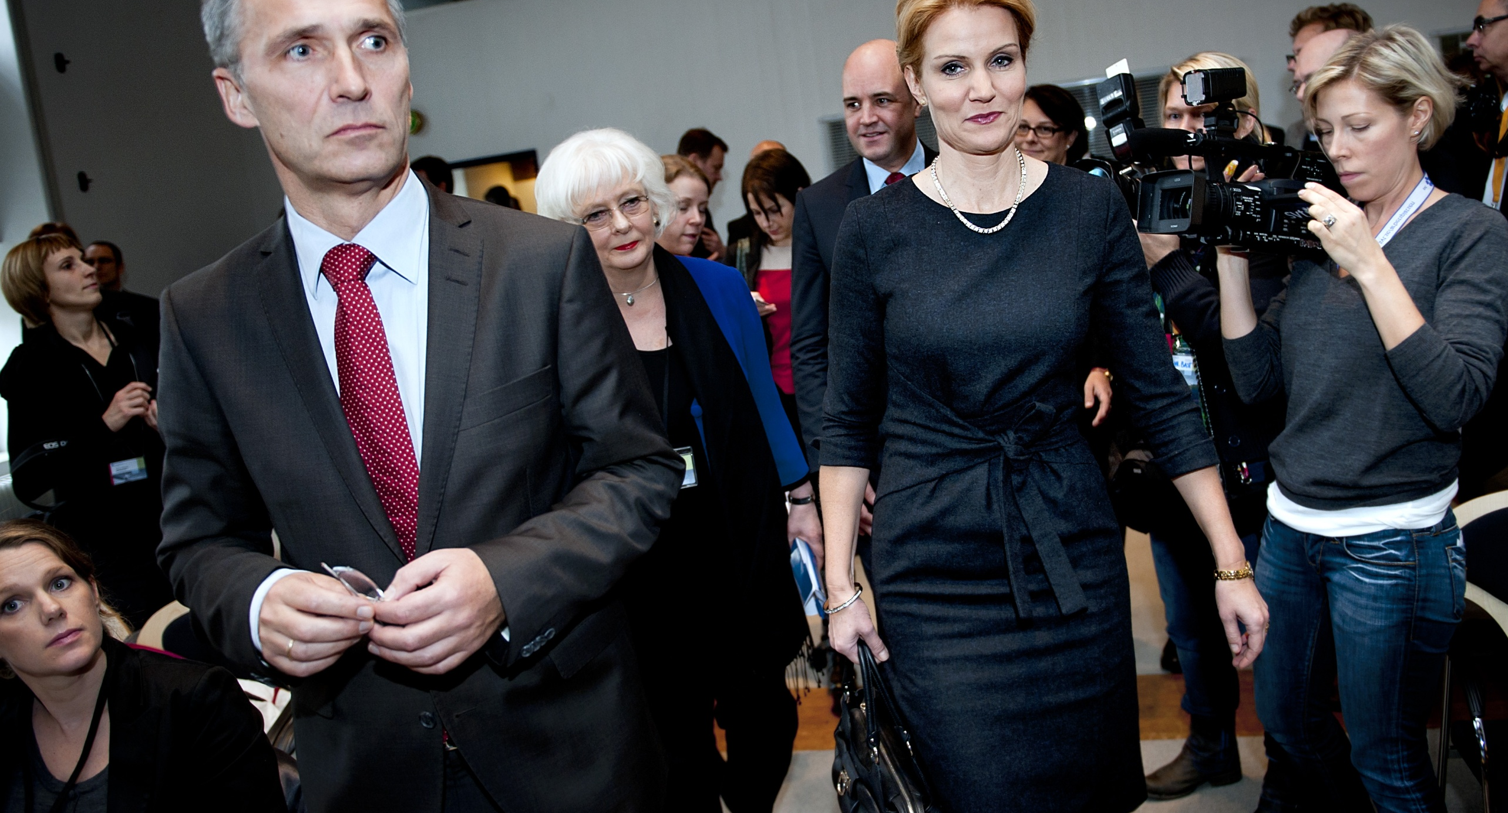
The Norwegian – or Nordic model..
Notes:
It is possible that this is so much just basic to you…but I find it hard…not to say impossible to present the Norwegian Quotas without presenting just a brief introduction to the Norwegian /Nordic Model to you…
It has been a mutual exhcange of ideas in building the Norwegian an the other Nordic countries society. A lot is appearantly shared ,- a lot is pretty much alike,- but be,- there ARE also differences! I am sure theese will be pin-pointed on later on. Here I will concentrate of the major lines:

Slide 8
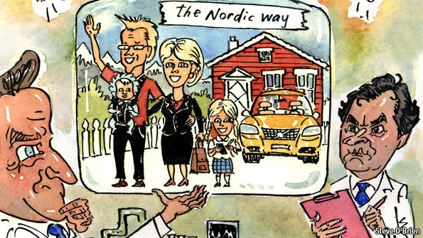
Norway – a country to live in or a way of living ?
Notes:
What kind of Society did this model make ??? How did we make our society…and what is this Model that is so much reaching international interest… How did we become a country described as this illustration shows in Economist last year….
Norway is considered to be one of the most sucessfull countries regarding equality between sexes and it iwas last year considered to be the best country to be a mother …
As you know,- globally the situation is very different. UN states that approx one billion are living in extreeme powerty- of wich 70% are women. At the same time 2/3 of all labour is done by women, Women are half of our population but are owning 1% of all property and land and are making only 10% of all earings.

Slide 9
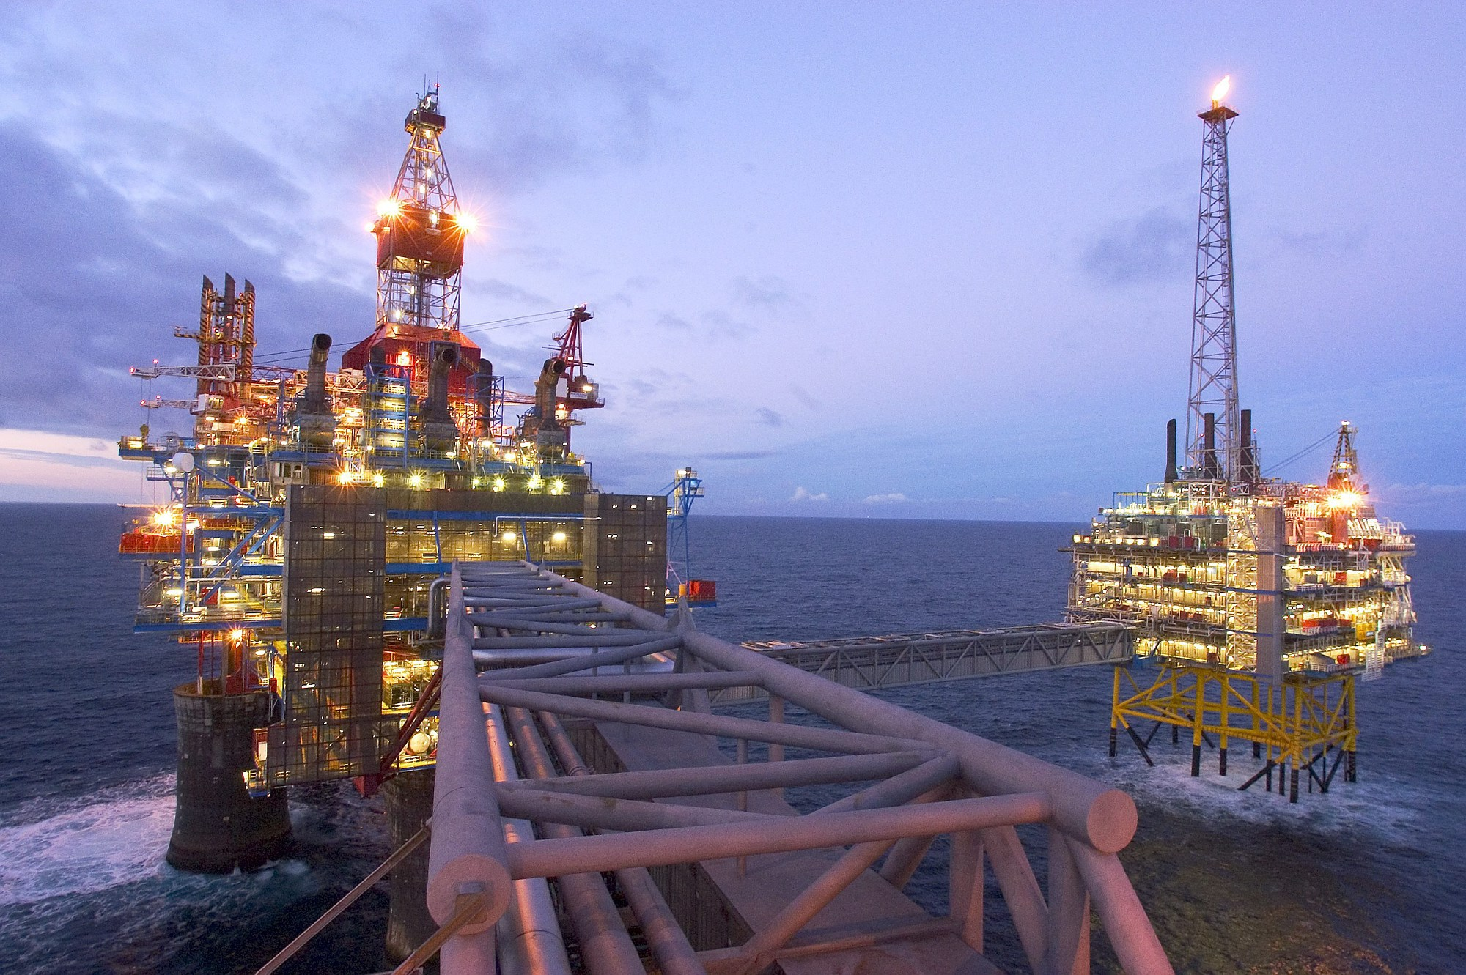
A question of luck?
A question of luck?
Notes:
Wel, some claim,- our model is not the answer….but our resources….and of course hey have been helping,- but the oil and gas is only counting for about 12 percent of our national assets….75 % of it is is based on the value of our human resources .
We believe that it is our human resources that makes us a rich country. They are our most important asset. ¾ av vår nasjonalformue. We believe that our welfare and success is based on high participation in working life The sustainabiity of future public welfare depends on our ability on making a continued high labour participation . This will be challanged more in times to come due to the eldering population.
Norway has been willing to take strong political actions – like quotas – to succeed. Quotas has not just not been easy comming,- they have been and still are controversial in Norway

Slide 10

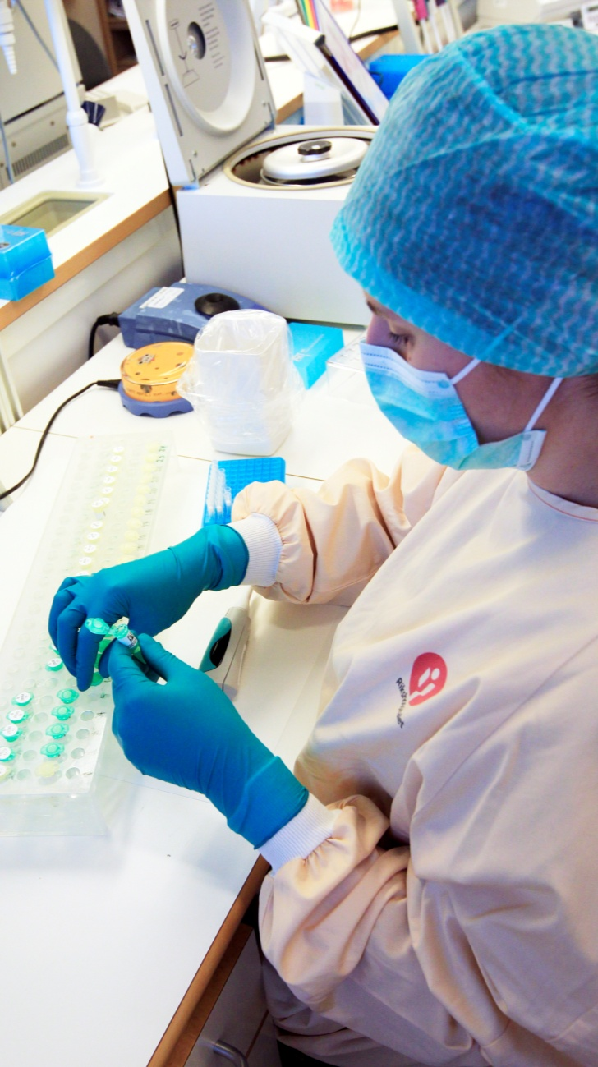
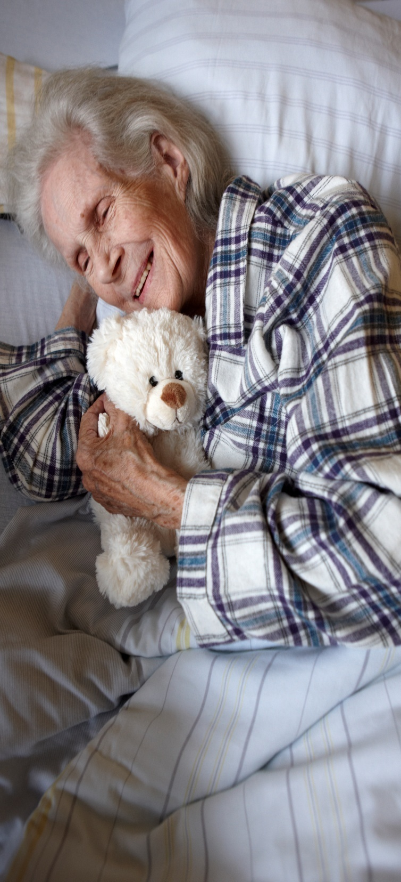
The Nordic model – a threefold
An economic model
A labor market model
A welfare
model
  Photo: Scanpix
  Photo: Scanpix
Notes:
The three factors are woven together ,-they are depending on each other - together this three models make the Nordic odel
Some of the highest rates of taxation in the world
An extensive public sector
Extensive social insurance systems
Strong unions
Relatively minor wage differences
Gender equality
Tripartite cooperation
Labor market policies
Openness to trade

Slide 11
Women in politics -wordwide
Less than 5 % of state leaders are women
In the world´s parliaments, women only hold 17 % of the seats on average
Of 180 countries: 120 parliaments have less than 20 % female members, only 19 have a female representation of more than 30 %.
Notes:
(figures from 2007-Interparliamentary Union)

Slide 12
Norway : Women and political representation
Female Prime Minister
Female in Government :50%
Female State Secretaries/vice minsters: 25%
Members of Parliament : 40%
Members of municipal councils: 38 % after elections in 2007 and 2011.
Only 17 % of mayors were women in 2003 increased only to 22% after elections in 2007 and 2011.
Most parties try to have 50% women on their list,- but it is up to each party to decide. Labour Party demands it in statues.
Notes:
Politics: Female participation in politics has increased strongly since the 1960 `s

Slide 13
Norway:Gender equality and formal rights
1854: Equal rights of inheritance for sons and daughters
1882: Women right to enter the university
1911: First woman elected to the Parliament
1913: Women gets the right to vote
1915: Legal act protects childrens rights irrespective of parents marrital statues
1920: The phrase ”A woman must obey her husband” is removed from the marriage service
1927: A new marriage act gives equal economic and legal rights to husband and wife
1975: The Kindergarten act – the municipalities are required to establish kindergartens
1977: The working environment act gives extended rights to maternal leave – 18 weeks paid leave (this is now extended to a year, and includes exclusive rights for the father)
1978: Gender equality act
1981. First female prime minister, Gro Harlem Brundtland 10 of 19 ministers in the government are women, women in parliament: 38%
2005: NLP government put kindergartens at top of political agenda – today we have finally got 100 % coverage of kindergartens and at affordable prices
Notes:
After the second world war (during the 1950s and 60s) It was regarded as a good that the women could be a housewife
From the 60s and 70s women started to participate in the working life, and they gained more economic independence.

Slide 14
Todays quotas
Today we have quotas in:
Business; state owned and inter-municipal companies as well as in of Public Limited Companies
Education and in positions in public sector
Politics
Notes:
Business:
For å styrke kvinners posisjon i næringslivet har Stortinget vedtatt en lov om at hvert av kjønnene skal være representert med minst 40 prosent i styrene til privat eide allmennaksjeselskaper (ASA) og noen offentlige eide foretak. Den reguleringen som har fått størst oppmerksomhet i senere tid er kvotering av kvinner til styreverv, som Stortinget vedtok i 2003. For statlige selskaper trådte loven i kraft 1. januar 2004. For allmennaksjeselskapene trådte loven i kraft 1.januar 2006 med to års overgangstid for etablerte selskaper. Da loven ble vedtatt var kvinneandelen i styrene i allmennaksjeselskapene syv prosent. Denne andelen er nå økt til 45 prosent (1.januar 2008). Se nærmere om fakta i boks 14.6.
State owned and inter-municipal companies complied by January 2006
The 500 PLCs complied by July 2008
7 % in 2003
40 % in 2008!
Politics: Kvinneandelen i politikken har økt sterkt siden slutten av 1960-tallet.
Etter stortingsvalget er kvinneandelen på Stortinget 40 prosent.
I kommunestyrene var kvinneandelen økt fra vel 35 prosent i 2003 til om lag 38 prosent i både i 2007 og 2011.
Andelen kvinnelige ordfører var i 2003 nesten 17 prosent, mens andelen var om lag 22 prosent etter valgene både i 2007 og 2011.
De politiske partiene har et viktig ansvar for å sikre en bedre kjønnsmessig balanse i kommunestyrene. De fleste politiske partiene har ordninger med kvoteringer, men praksis varierer fortsatt fra parti til parti.

Slide 15
Quotas in business: 40%
Private owned companes are excluded
2003: Quotas on female board members in Public owned companies from 1.1.2004
2006: Quotas in public limited companies were introduced - At that time7% of board members were women. This aumented to 45% in 2008.

Slide 16
We…I am Hilde
By profession I am a Spanish translator , I worked for several years as a Human Resorce Director and the last three years I have been the Major of Nittedal, a municipality just outside Oslo, our capital.
I have been active in the Labour party the last 25 years
I was a political adviser from 2000-2001 for the Minister of Labour and Administration
I was a vice- Major from 1999 -2007 in Nittedal
I am married, with two sons (30 and 26) and I have three beautiful grandchildren
Notes:
Valgt 1997 – den lille jenta
Valgt 1999 – klappet på hodet
Møtt argumenter om at jeg hadde barn, at jeg hadde jobb, at jeg var aktiv andre steder

Slide 17
Gender equality and democracy
The link between gender quality and democracy is self-evident
Women account for more than half of the population -if the majority of citizens do not have full political right and ability to influence, the society is not democratic!
Norwegian Women have fought for decades for more gender equality, we have benefited from working together and networking

Slide 18
Quotas in politics
Quotas are required to make space for women
Quotation makes gender balance and it stimulates good politics
The result is a better society !
But are quotas enough ?
------NO

Slide 19
In an equal society
Rights to childcare and kindergarten are fundamental
Paid parental leave with quotas for both parents
Possibilities for part time work and flexibility in working hours

Slide 20
How to achieve gender balance in local politics
Use the quotas – lift men when necessary!
Get approprirate support for elected cadidates for babysitting/parentsitting and rethink how to beat barrieres agains doing political work
Give political cadidates the necessary training – boost their self esteem
Make politics easy and fun!
Create arenas for social outcome as well as political development. ”Politics is made in meeting people”
Notes:
Fortell om Nittedal og kvotering av menn
Fortell om nye behov for omsorgsavlastning – få med nye grupper
Ortell om slutten på papir veldet!
Fortell om din egen historie

Slide 21
Is everything done in Norway?
NO ----There are lots more to be done!
A majority of the majors are still men
The new government has declared gender equality is to be of less importance for the future ….we fear that this is a step towards resign in the battle of the gender balance
Legal measures has to be taken to secure anti-discrimination
Double career patterns needs to be further facilitated
Reconciliation of work and family life
  Single parenthood and work
  Unequal pay is still a challenge
  Involuntary underemployment among women – part-time work
  Discrimination on the ground of pregnancy is still on going
  Gender segregated labour market
  Low proportion of female entrepreneurs
  Women with non-western minority background are worst off in the labour market.

